Slide 1
Ionic Bonding
By Alex, Matt, Kit and Katie

Slide 2
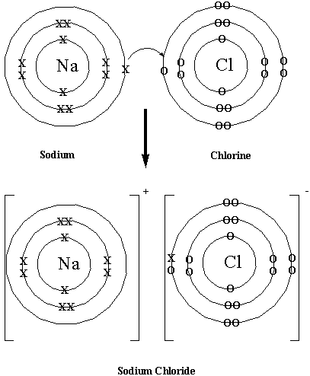
What is ionic bonding?
Ionic bonding results from the electrostatic attraction between oppositely charged ions.
Positive ions are formed when an atom loses electrons
Negative ions are formed when an atom gains electrons.

Slide 3
Example of ionic bonding
Atom | Electronic configuration | Dot and Cross diagram | Ion | Electronic configuration | Dot and Cross diagram
Na | 2, 8, 1 |  | Na | 2, 8
Cl | 2, 8, 7 |  | Cl¯ | 2, 8, 8
+

Slide 4
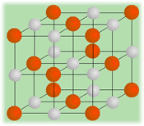
Physical properties of ionic compounds
They are crystalline solids with high melting points:
Ionic compounds are arranged in a giant ionic lattice. The oppositely charged ions are attracted to each other. These attractions outweigh repulsions between similarly charged ions because each ion is surrounded by oppositely charged ions.
The strong ionic bonds mean that the melting points of ionic compounds are high because they take a lot of energy to break.

Slide 5
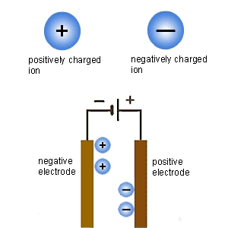
Physical properties of ionic compounds
They conduct electricity in aqueous solution or when molten:
The passing of an electric current makes ionic compounds decompose in a process called electrolysis. Ions are through aqueous solution and molten compounds and are attracted to the oppositely charged electrode.
Positive ions (cations) are attracted to the negative electrode (cathode).
Negative ions are attracted to the positive electrode (anode).
At the electrode ions are discharged, so cations (positively charged ions) gain electrons and anions (negatively charged ions) lose electrons.

Slide 6
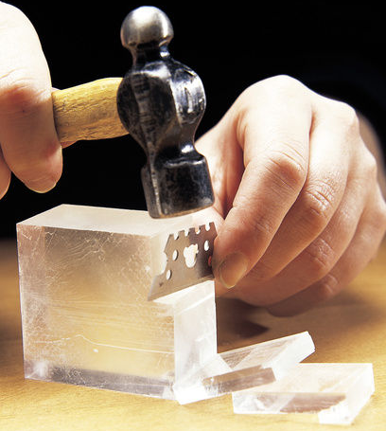
Physical properties of ionic compounds
They are hard and brittle with crystals that cleave easily:
The cleavage of gemstones and ionic crystals occurs between planes of ions in the ionic lattice. A crystal will split cleanly if it is tapped sharply in the direction of one of the crystal planes.
As the plane of ions is displaced, ions of a similar charge come together. The repulsion between ions of a similar charge cause the crystal to split.

Slide 7
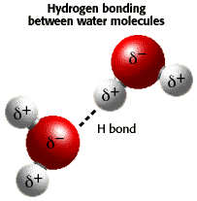
Physical properties of ionic compounds
They are often soluble in water:
All metal nitrates, most metal nitrates, most metal chlorides and most Group 1 salts are soluble in water.
Ionic compounds that carry higher charges on ions tend to be less soluble or insoluble.
When ionic compounds dissolve, energy must be provided to overcome the strong attractive forces between the ions in the lattice. This energy is provided by the strong attractive forces between water molecules and the ions.
Water molecules are attracted to ions by strong electrostatic forces.
The oxygen atoms of water molecules are attracted to positive ions. The hydrogen atoms of water molecules are attracted to negative ions. This happens because water molecules are polar.

